Slide 1
CSC 735 – Data Analytics
Chapter 8
Structured APIs – Joins

Slide 2
Joins
Allow us to join together the data from multiple datasets
This allows us to analyze the combined dataset in ways that we couldn’t with just each individual dataset
Customers table
Transactions table

Slide 3
Join Expressions
Every join must have a join expression and a join type
Join expression aka join condition
The join expression is used to decide which rows from the left dataset join with which rows in the right dataset

Slide 4
Join Types
A join type determines what should be in the result of the join
Join types include: inner joins, outer joints, …

Slide 5
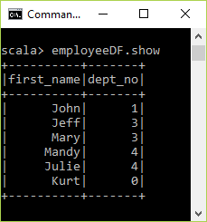
Creating the Datasets
case class Employee(first_name:String, dept_no:Long)
val employeeDF = Seq( Employee("John", 1),
Employee("Jeff", 3),
Employee("Mary", 3),
Employee("Mandy", 4),
Employee("Julie", 4),
Employee("Kurt", null.asInstanceOf[Int])
).toDF
employeeDF.createOrReplaceTempView("employees")

Slide 6
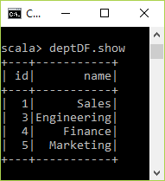
Creating the Datasets
case class Dept(id:Long, name:String)
val deptDF = Seq( Dept(1, "Sales"),
Dept(3, "Engineering"),
Dept(4, "Finance"),
Dept(5, "Marketing")
).toDF
deptDF.createOrReplaceTempView("departments")

Slide 7
Inner Joins
The most commonly used join type with the join expression containing the equality comparison
The result will contain the rows for which the join expression evaluates to true
Inner join is the default join type

Slide 8
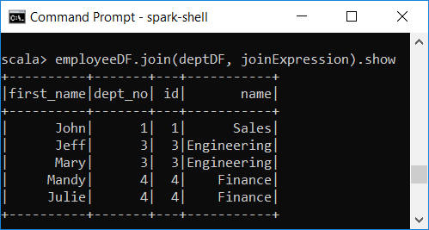
Inner Joins
val joinExpression = employeeDF.col("dept_no") === deptDF.col("id")
employeeDF.join(deptDF, joinExpression, "inner").show
employeeDF.join(deptDF, joinExpression).show
spark.sql("""select * from employees JOIN departments on dept_no == id""").show

Slide 9
Inner Joins (cont.)
The join expression can be specified inside the join transformation
The join expression can be specified using the where transformation
If the column names are not unique, we need to specify which DF a particular column comes from
employeeDF.join(deptDF, 'dept_no === 'id).show
employeeDF.join(deptDF).where('dept_no === 'id).show
employeeDF.join(deptDF, employeeDF.col("dept_no") === deptDF.col("id")).show

Slide 10
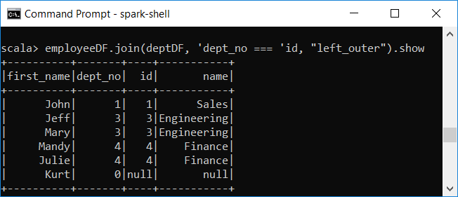
Left Outer Joins
The result includes the rows from the inner join plus the nonmatching rows from the left dataset
For nonmatching rows, Spark fills in null for the columns of the right dataset

Slide 11
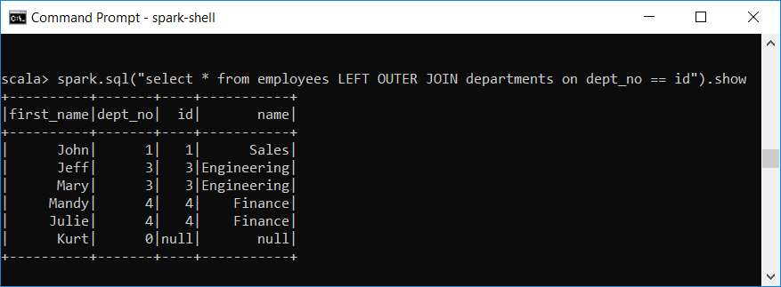
Left Outer Joins – SQL Way

Slide 12
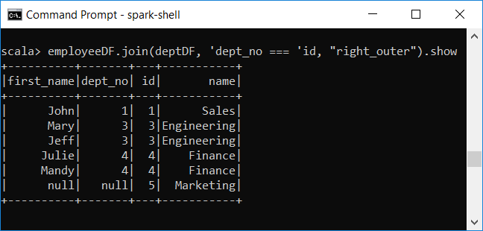
Right Outer Joins
Analogous to left outer join type,
Result contains matching rows + nonmatching rows from the right dataset

Slide 13
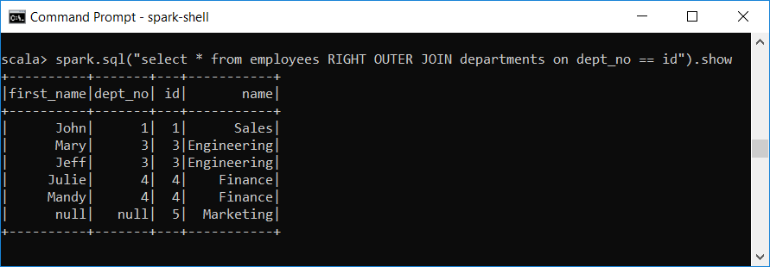
Right Outer Joins – SQL Way

Slide 14
Outer Joins (aka Full Outer Joins)
Combines both the left outer join and the right outer join
employeeDF.join(deptDF, 'dept_no === 'id, "outer").show
spark.sql("""select * from employees FULL OUTER JOIN departments on dept_no == id""").show

Slide 15
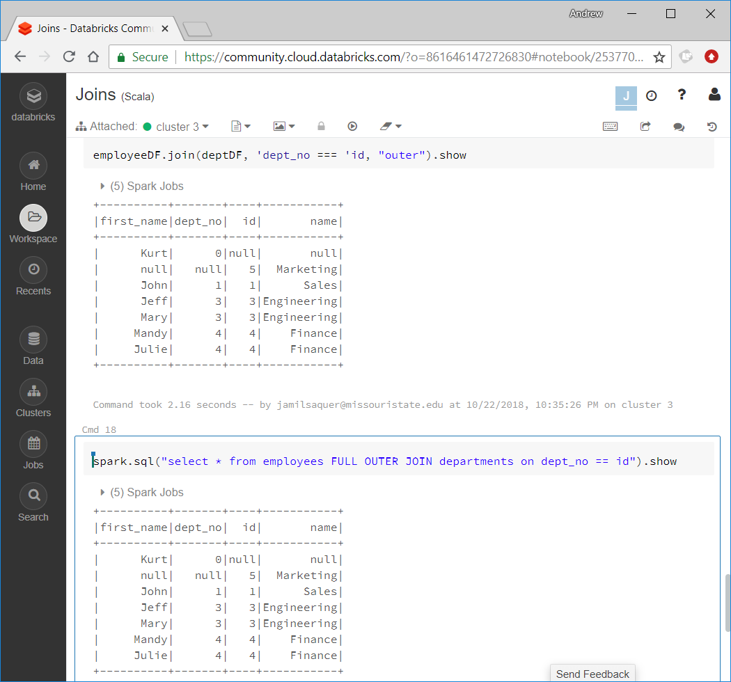

Slide 16
Left Semi Joins
It is similar to the inner join but contains rows only from the left dataset
I.e., the result dataset contains only the rows in the left dataset that have matching rows in the other dataset

Slide 17
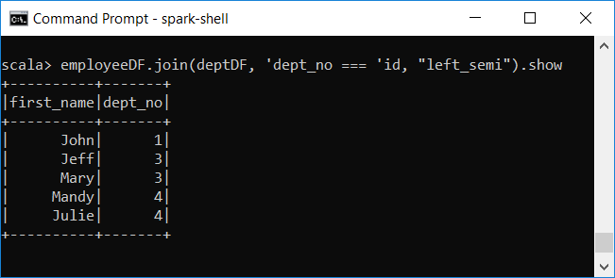
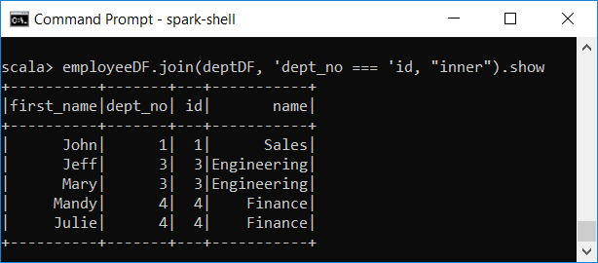
Left Semi Joins - Example

Slide 18
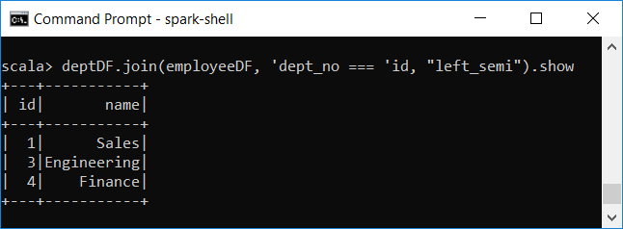
Left Semi Joins - Example

Slide 19
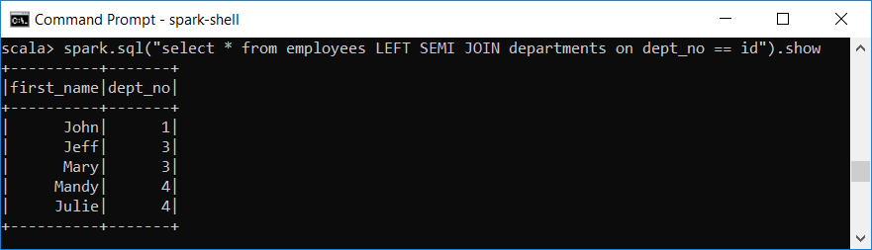
Left Semi Joins – SQL Way

Slide 20
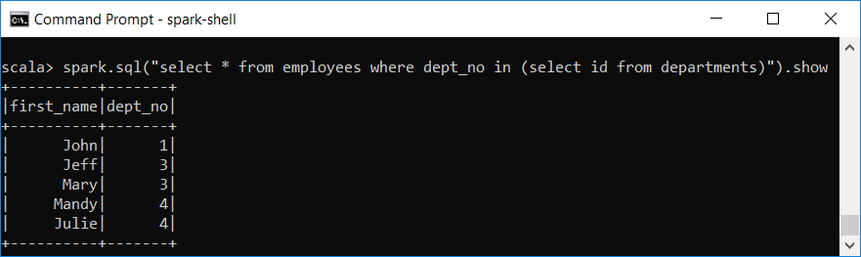
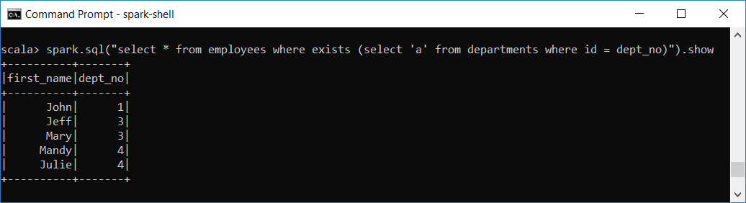
Left Semi Joins – Equivalent SQL Commands
You can think of left semi join as IN or EXISTS in SQL

Slide 21
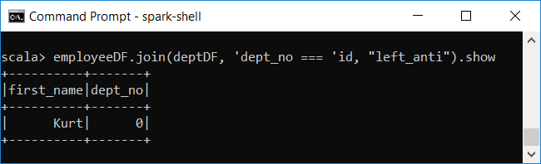
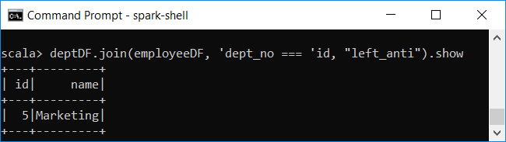
Left Anti Joins
Left anti join results in rows from only the left dataset if, and only if, there is NO matching row in right dataset

Slide 22
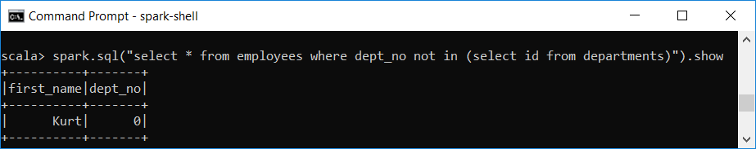
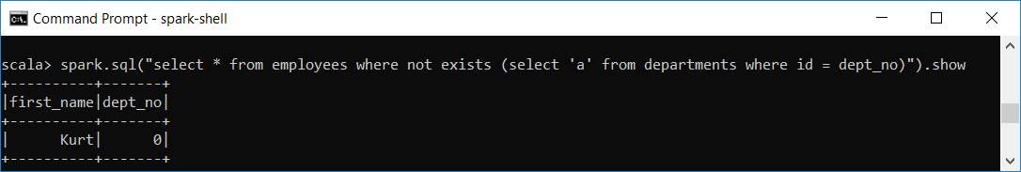
Left Anti Joins – Equivalent SQL Commands
You can think of anti joins as a NOT IN or NOT EXISTS SQL style filter

Slide 23
Cross (aka Cartesian) Joins
Simple to use because no join expression is needed
Every single row in the left dataset will join with every single row in the right dataset
Size of the result dataset can be huge
Better to specify as a transformation
employeeDF.crossJoin(deptDF).show
//SQL Way
spark.sql("select * from employees CROSS JOIN departments").show()

Slide 24
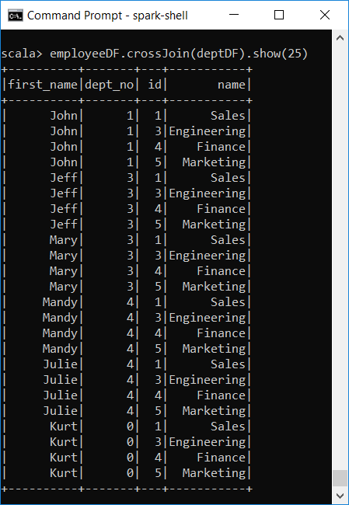
Cross Joins

Slide 25
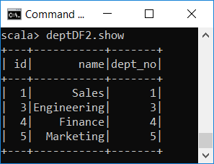
Handling Duplicate Column Names
A problem with joins is that a resulting DF can have multiple columns with the same name
If a DF has two columns with the same name, it would be difficult to refer to these columns
val deptDF2 = deptDF.withColumn("dept_no", 'id)
deptDF2.show

Slide 26
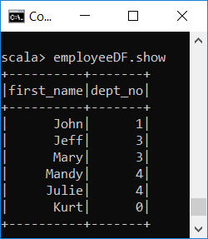
Handling Duplicate Column Names
val dupNameDF = employeeDF.join(deptDF2, employeeDF.col("dept_no") === deptDF2.col("dept_no"))
dupNameDF.printSchema
root
|-- first_name: string (nullable = true)
|-- dept_no: long (nullable = false)
|-- id: long (nullable = false)
|-- name: string (nullable = true)
|-- dept_no: long (nullable = false)
dupNameDF.select("dept_no")
org.apache.spark.sql.AnalysisException: Reference 'dept_no' is ambiguous, could be: dept_no, dept_no.;

Slide 27
Handling Duplicate Column Names
There are several ways to deal with duplicate columns
Using a different join API
Qualifying a column name with its original DF
Renaming a column before the join
Dropping a column after the join

Slide 28
1. Using a Different Join API
These versions of join automatically remove duplicate column names
join(right: DF, usingColumn: String): DF
Inner join with a single column
join(right: DF, usingColumns: Seq[String]): DF
Inner join with multiple columns
join(right: DF, usingColumns: Seq[String], joinType: String): DF
Join with multiple columns and a join type

Slide 29
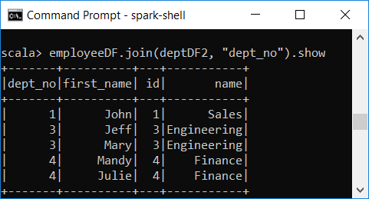
Using a Different Join API – Example

Slide 30
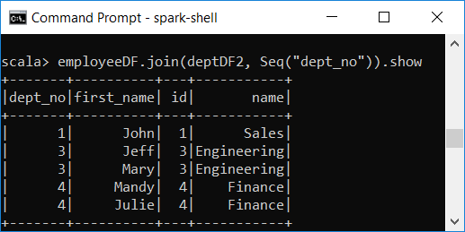
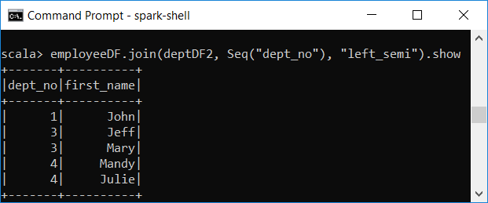
Using a Different Join API – Example

Slide 31
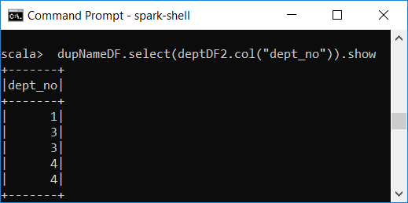
2. Qualifying a Column Name with its Original DF
The joined DF remembers which columns come from which original DF during the joining process
dupNameDF.select(deptDF2.col("dept_no"))

Slide 32
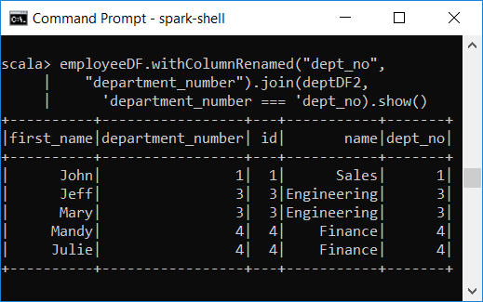
3. Renaming a Column before the Join
Use the withColumnRenamed transformation before doing the join
employeeDF.withColumnRenamed("dept_no", "department_number")
.join(deptDF2, 'department_number === 'dept_no).show()

Slide 33
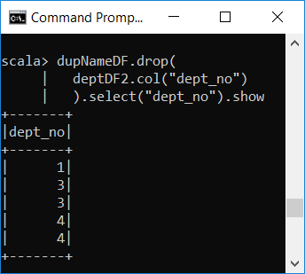
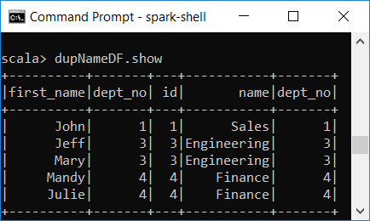
4. Dropping a Column after the Join
We need to refer to the column via the original source DF
val dupNameDF = employeeDF.join(deptDF2, employeeDF.col("dept_no") === deptDF2.col("dept_no"))
dupNameDF.drop(deptDF2.col("dept_no")).select("dept_no").show

Slide 34
How Spark Performs Joins
Joins can be expensive
There are two join strategies: shuffle "hash" join and broadcast join
Strategy used is based on the size of the two datasets
If both datasets are large (big tables), shuffle hash join is used
When at least one of the datasets is a small table, broadcast join is used

Slide 35
Shuffle "Hash" Join
A join combines the matching rows of two datasets
Matching rows need to be brought to the same partition
First, compute the hash value of the columns in the join expression of each row in each dataset
Shuffle the rows with the same hash value to the same partition
Join these rows

Slide 36
Broadcast "Hash" Join
Applicable when one of the datasets is a small table
Broadcast a copy of the entire small table to each of the partitions of the larger dataset
Iterate through each row of the larger dataset to find the matching rows to join

Slide 37
Broadcast Hash Join
Broadcast join is preferred when possible
Spark can automatically figure out whether to use a broadcast hash join or shuffle hash join
We can provide a hint to Spark to use a broadcast join
import org.apache.spark.sql.functions.broadcast
//print the explain plan to verify broadcast hash join strategy is used
employeeDF.join(broadcast(deptDF), employeeDF.col("dept_no") === deptDF.col("id")).explain()
== Physical Plan ==
*(1) BroadcastHashJoin [dept_no#634L], [id#640L], Inner, BuildRight, false
:- LocalTableScan [first_name#633, dept_no#634L]
+- BroadcastExchange HashedRelationBroadcastMode(List(input[0, bigint, false]))
+- LocalTableScan [id#640L, name#641]

